Slide 1
Web Application Re-Imagined for Today’s Demanding End Users
Keith Elder
Director, Software Engineering, @QuickenLoans
http://keithelder.net
@keithelder
http://deepfriedbytes.com - Podcast

Slide 2
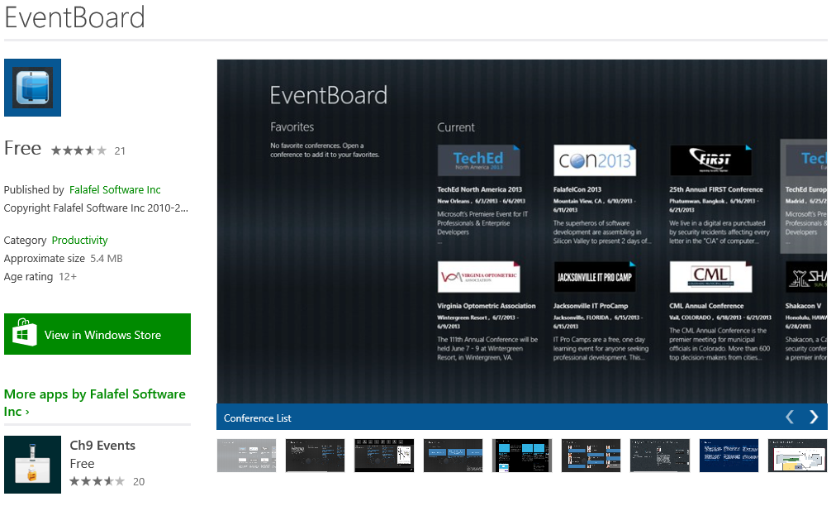
http://www.eventboardmobile.com/download

Slide 3





















































Platinum Sponsors
Gold Sponsors
Silver Sponsors

Slide 4



Deep Fried Bytes is an audio talk show with a Southern flavor hosted by technologists and developers Keith Elder and Chris Woodruff. The show discusses a wide range of topics including application development, operating systems and technology in general. Anything is fair game if it plugs into the wall or takes a battery.
http://deepfriedbytes.com

Slide 5
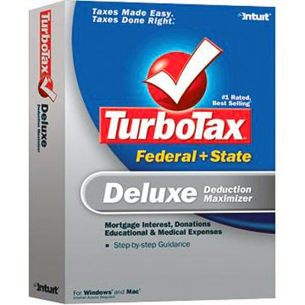

Quicken Loans

Slide 6
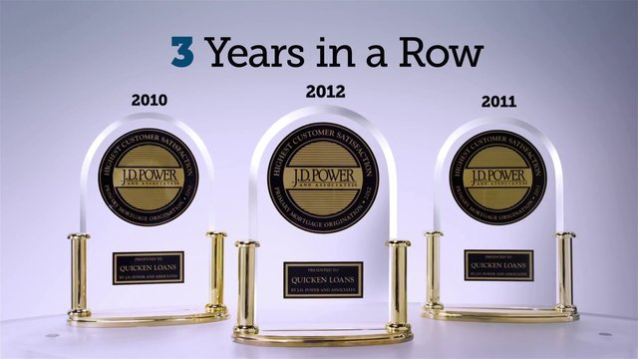

2013
4 Years in a Row

Slide 7
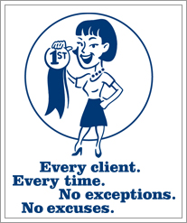
Quicken ISM

Slide 8
My Goal
Get you thinking different about how you build your applications.

Slide 9
Disclaimer!

Slide 10
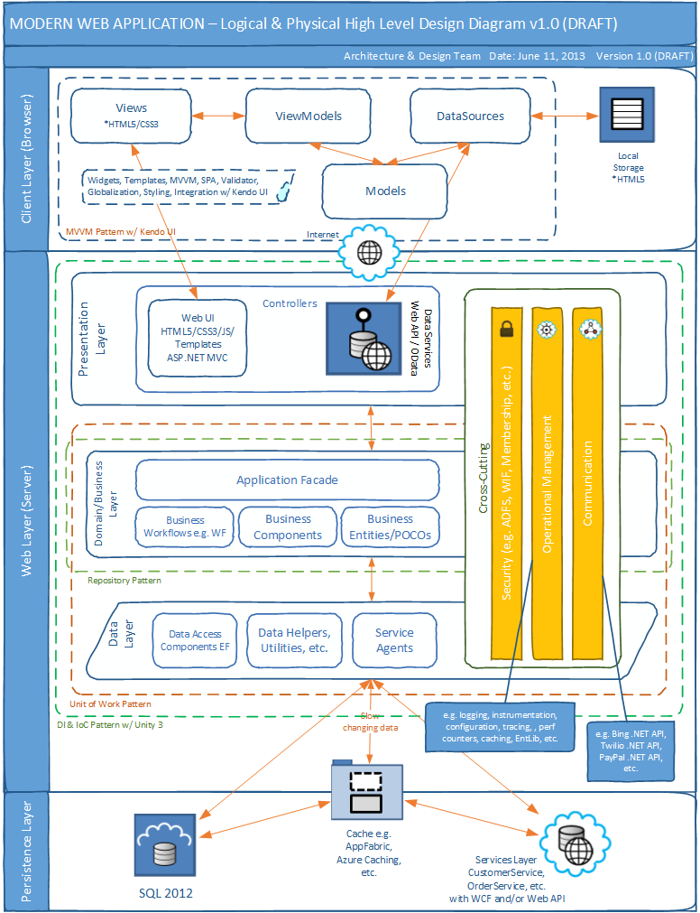

Slide 11

Web Request
Web Server
Blog Architecture
Database
Fetch Data

Slide 12
Web Request
Enterprise Blog Architecture
Web Server
Database
Fetch Data
Cache

Slide 13
Web Request
Load Balancer
Super Enterprise Blog Architecture
Web Farm
Fetch Data
Database Cluster
Cache Cluster

Slide 14
What has happened in the last several years that end-users have figured out we could have been giving them all along?

Slide 15
Real-time Updates and Push Notifications

Slide 16


Slide 17

He exposed our secret to the world.

Slide 18
Get angle brackets (html)
Services
Architecture
Web Server
Get curly braces (data)
REST API
Fetch Data
Database
Cache

Slide 19
Web Server
Get angle brackets (html)
Queued Services
Architecture
Get curly braces (data)
Fetch Data
REST API
Database
Queue
Pub/Sub
Cache
Windows Service
Notes:
We no longer build single monolithic applications any longer. Anyone caught doing so shall be terminated immediately.

Slide 20
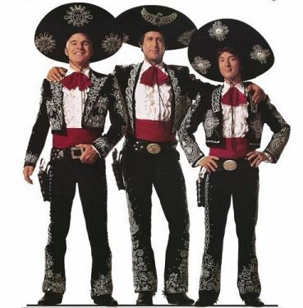

Slide 21
Three Applications
Web UI
REST API
Windows Service
Composite Application Monolithic

Slide 22
Monolithic apps are out. Composite applications are the new norm.

Slide 23
It is all about messaging.
The only way to get them to all talk to one another.

Slide 24
Demo

Slide 25
Web, API, Backend
Roles they each serve.

Slide 26
Web UI
Borrows from the learnings of the *Smart Client* era. Doesn’t do anything but display html and data to the screen.

Slide 27
REST API
The Web UI interacts gets and stores data through here. There are no other means of it getting or retrieving data.
Provides a means for other UIs (mobile, tablet, other systems) to interact.

Slide 28
REST API
Handles request/reply where absolutely necessary
Primary job in life is to fan out calls
Generates messages to be processed
Commands
Events
Does minimal work as possible to return to caller as fast as possible
Everything else is handled by backend Windows Services

Slide 29
REST API
Design considerations
Assume everyone is going to attack you
Who is invoking you
Metrics / Stats
Identification of caller
Who are you and what can you do?
Security
More than SSL may be required
Document it
Help your clients, give them something other than just the API

Slide 30
REST API Calls
Option 1 – Request / Reply
Get data / Store data
Create and send any commands and events to message queue
Return
Option 2 - Async
Store data
Get data (pulling credit is a good example)
Create and send any commands to message queue
Return

Slide 31
Windows Service(s)
The message processor(s). Processes commands and events that have been placed either in the queue or topic (pub/sub). Also creates and fires off commands and events.

Slide 32
NOTE: Use pub/sub to communicate to all of your distributed services commands like reset cache etc.
Queue
Pub/Sub
Windows Service
Windows Service
Windows Service
Database
Cache
REST API
Web Site

Slide 33
Why are we doing this?

Slide 34
Build for failure.
Build for speed.

Slide 35
Business Domain
Loan system
Saves clients
When a client is saved we are instructed by the business to do the following:
Save to database
Send client data to vendor for snail mail marketing
Send welcome email
Run client qualification (lots of moving pieces)

Slide 36
public ClientWithQualification SaveNewClient(Client c)
{
SaveToDatabase(c);
NotifyVendorForMailing(c);
SendWelcomeEmail(c);
var cq = new ClientWithQualification(c);
cq.Qualification = QualifyNewClient(c);
return cq;
}
private ClientQualification QualifyNewClient(Client c)
{
var qual = new ClientQualification();
qual.Weather = GetWeather(c);
qual.FacebookData = GetFaceBookData(c);
qual.TwitterData = GetTwitterData(c);
qual.ClosingMetrics = GetClientClosingBIData(c);
return qual;
}
Notes:
Who has written code like this? Many of you I know have. Probably every single person that is reading this.
While it is easy to read and doesn’t looking that scary, what it is doing is essentially saving a client’s information into the system.
There are multiple steps to saving a new client. The first is to get it into the database. The next is we need to notify another system we have a new client, then we need to send an welcome email and then we need to run qualification.
While all of this is happening what is happening in the UI to the client? NOTHING.
Even if we run all of this multi-threaded, we still have to wait until everything completes before we can return to the client.
Not only that but this code is riddled with failure. Let’s look at the next slide where I added comments to all failure points.

Slide 37
public ClientWithQualification SaveClient(Client c)
{
SaveToDatabase(c); //failure
NotifyVendorForMailing(c); //failure
SendWelcomeEmail(c); //failure
var cq = new ClientWithQualification(c);
cq.Qualification = QualifyNewClient(c); // multiple failures
return cq;
}
private ClientQualification QualifyNewClient(Client c)
{
var qual = new ClientQualification();
qual.Weather = GetWeather(c); //failure
qual.FacebookData = GetFaceBookData(c); //failure
qual.TwitterData = GetTwitterData(c); //failure
qual.ClosingMetrics = GetClientClosingBIData(c); //failure
return qual;
}

Slide 38
Problems
Failure is inevitable
Crossing boundaries
Http isn’t a transactional protocol
Recovery

Slide 39
Using Our Queue with Request/Reply
public object Post(Client client)
{
((DbSet<Client>)_db.Clients).Add(client);
((DbContext)_db).SaveChanges();
var event = Mapper.Map<ClientCreatedEvent>(client);
Task.Run(() =>
{
_sender.Send<ClientCreatedEvent>(event);
}
);
return client.Id;
}

Slide 40
Using Our Queue Async
public object Post(Client client)
{
var cmd = Mapper.Map<CreateClientCommand>(client);
Task.Run(() =>
{
_sender.Send<CreateClientCommand>(cmd);
}
);
return client.RequestId;
}

Slide 41
Event
Queue
Message Router
ClientCreatedEventHandler
Handle(IEvent event);

Slide 42
Queue
Message Router
ClientCreatedEventHandler
Handle(IEvent event);
ClientQualificationCommand

Slide 43
Workflow of Commands / Events
Fires the CreateClientCommand
ClientCreatedEvent
Fires the NotifyVendorCommand
NotifyVendorCompletedEvent (push)
Fires the SendEmailCommand
SendEmailCompletedEvent (push)
Fires the QualificationCommand
QualificationCompletedEvent (push)
Notify UI all processing is completed

Slide 44
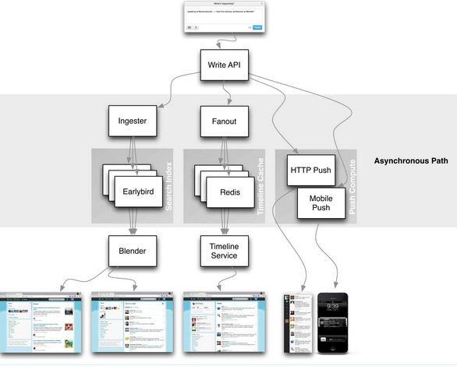

Slide 45
IIS/AngularJS
Technologies
SignalR
Service Stack Wep API
SQL /
NOSQL
RabbitMQ
RabbitMQ
App Fabric
Top Shelf

Slide 46
Demo
StartR – http://github.com/keithelder/StartR

Slide 47
Web Application Re-Imagined for Today’s Demanding End Users
Keith Elder
Director, Software Engineering, @QuickenLoans
http://keithelder.net
@keithelder
http://deepfriedbytes.com - Podcast

